Slide 1
Prince William Forest Park
Notes:
This presentation is meant to prepare you and your students for your school’s trip to the NatureBridge program at Prince William Forest Park.

Slide 2
Overview
About NatureBridge
Prince William Forest’s Classroom
A Typical Day at NatureBridge
Learning Groups
Lodging & Dining
What to Bring
Student and Family Agreements
Next Steps

Slide 3
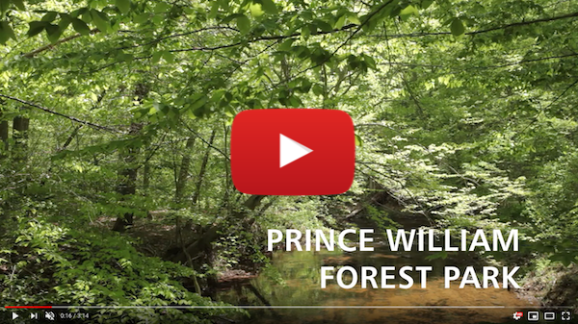
About NatureBridge
Nonprofit organization, founded in 1971
Partner of the National Park Service
Campuses include: Golden Gate, Yosemite and Olympic
Welcomes over 600 schools and 30,000 students each year
Notes:
NatureBridge:
•nonprofit organization
•Partner of the National Park Service, our other campuses are in Golden Gate and Yosemite in California, and Olympic in Washington state.
•NatureBridge has been offering programs since 1971, has served over a million students, and serves at least 30,000 each year
•Prince William Forest Park program – This is the 8th school year of our first East Coast program, serves over 40 schools and about 2,000 students each year

Slide 4
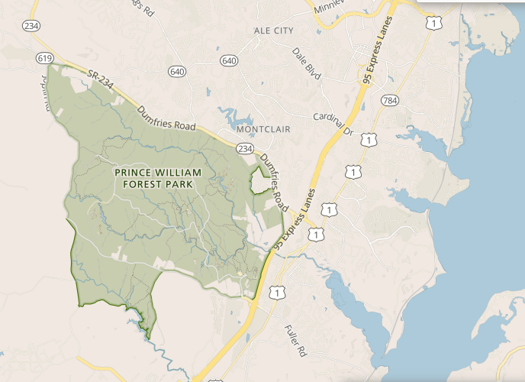
Prince William Forest
Only 35 miles south of Washington D.C.
15,000 acres of piedmont forest
Pristine streams, waterfalls, 37 miles of trails
Notes:
Prince William Forest Park – National Park in your backyard!
•23 square mile park, bordering Quantico Marine Base
•15,000 acres of piedmont forest
•Pristine streams, waterfalls, 37 miles of trails
•The star marks the location of Cabin Camp 1, the site of NatureBridge programs

Slide 5
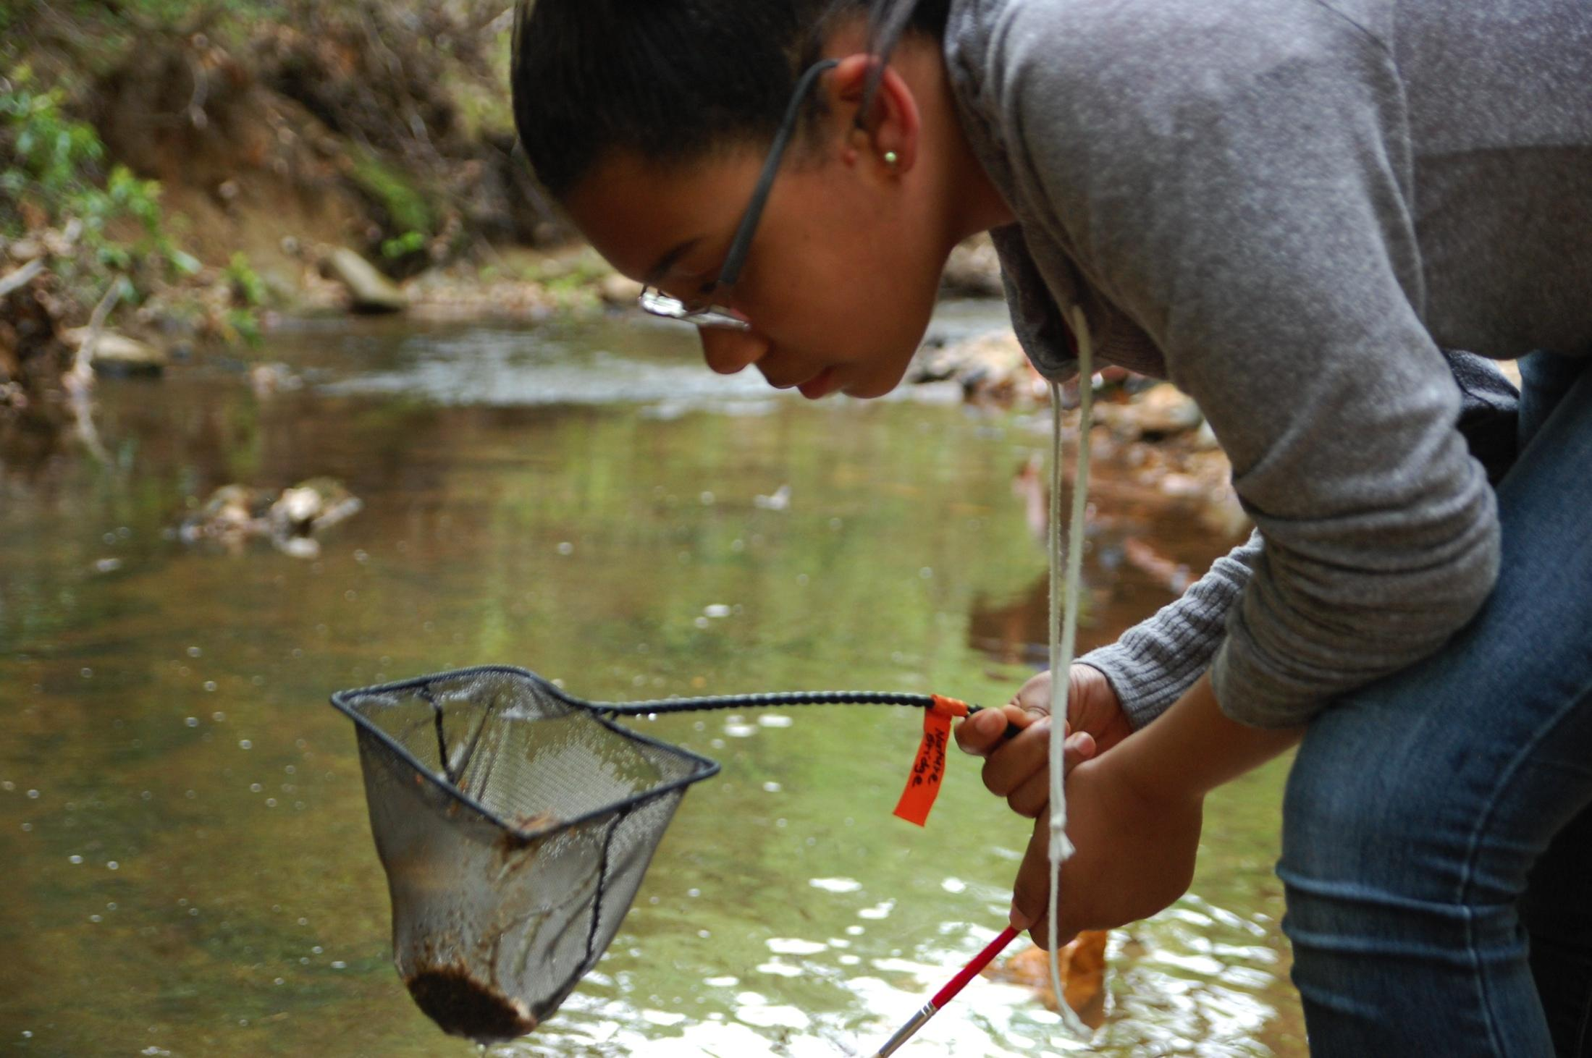
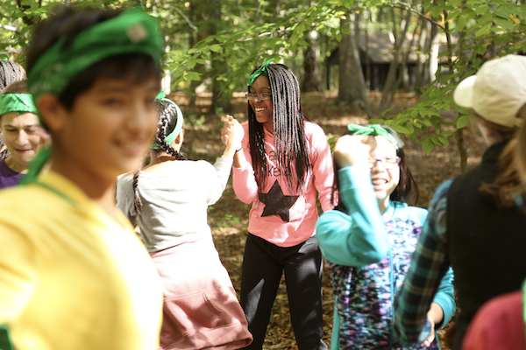
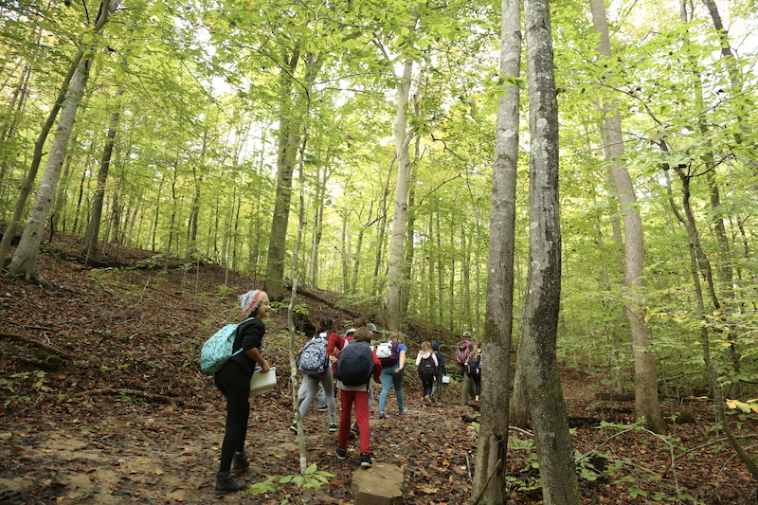
Prince William Forest’s Classroom
Environmental Science
Team Building &
Self-Reflection
Experiencing the Outdoors
Notes:
The Park provides a beautiful setting for science experiments, spending time outdoors, and getting to know classmates and teachers better.

Slide 6
Sample Day
8:00 a.m. Breakfast*
9:00 a.m. Trail day begins ~12:00 p.m. Lunch on trail ~4:00 p.m. Recreation time (chaperones will supervise) 6:00 p.m. Dinner* 7:15 p.m. Evening program 9:30 p.m. Quiet campus, lights out
*Meal times may change if there are multiple meal shifts. Early meals: 7:00 a.m. and 5:00 p.m. Late meals: 8:00 a.m. and 6:00 p.m.
Notes:
Sample activities on the trail: - water quality testing, identifying plants and animals (including the park’s many reptiles and amphibians), group games and team challenges, hiking up to 4 miles in a day (spread out with activities in between)
Science investigations: asking questions, making observations, collecting data
During meals: lessons on food waste, landfills, and composting
We support our Teachers and Chaperones. They supervise students before and after the trail day (until 9:00AM and after 4:00PM)

Slide 7
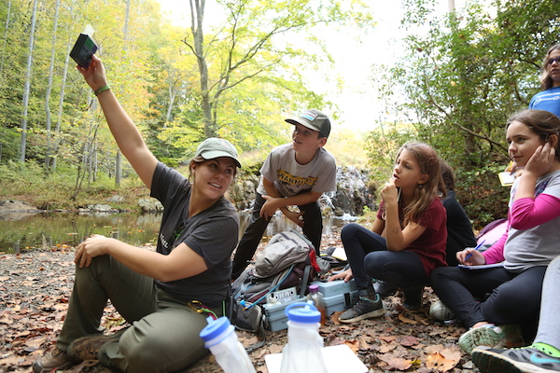
Learning Groups
12-15 students and 1 or 2 chaperones
Spend the day together on trail
Learning Groups are led by professional NatureBridge educators
Bachelor’s Degree or equivalent work and training experience
cleared background checks
certified to manage risk in the field, trained in Wilderness First Aid
Learning Groups will be arranged by your school’s group coordinator
Notes:
Educators – high-quality, outdoor teachers
•Our focus is on personal growth, improved interpersonal skills, and increased academic ability
•We strive to create a community atmosphere in which all students experience support and success.
•Educators prepare specifically for each group they work with using information provided by the school

Slide 8
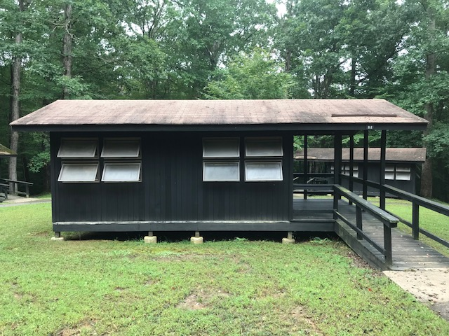
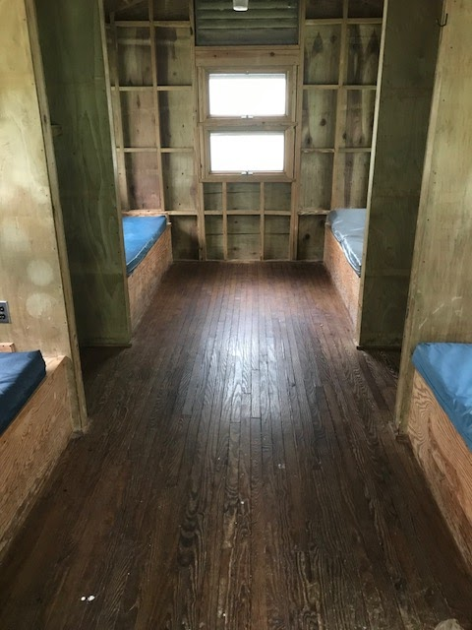
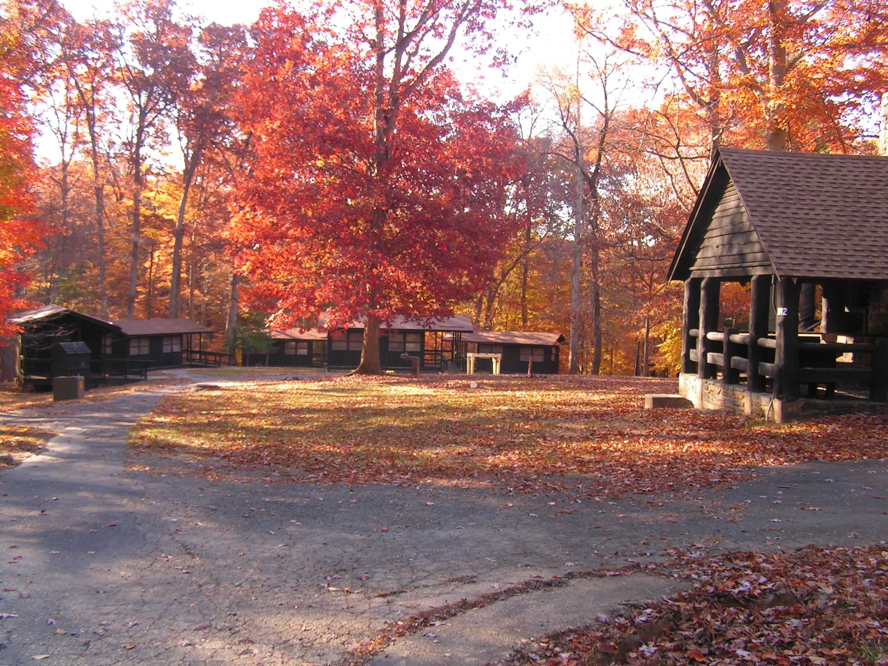
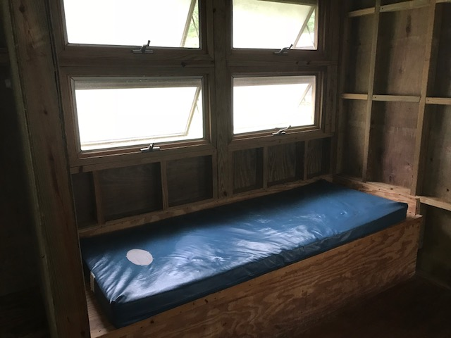
Lodging
Cabin Camp 1
Inside the cabins
Notes:
Accommodations:
4-6 students per cabin (some bunk beds, some single)
Foam mattresses
You will bring sleeping bag, pillow, etc
There are eight cabins in each Cabin Unit.
Schools can choose to assign cabins however they like, as long as there are at least two adults in each Cabin Loop.
There will typically not be an adult in every cabin with students, but all of the cabins are close to one another

Slide 9
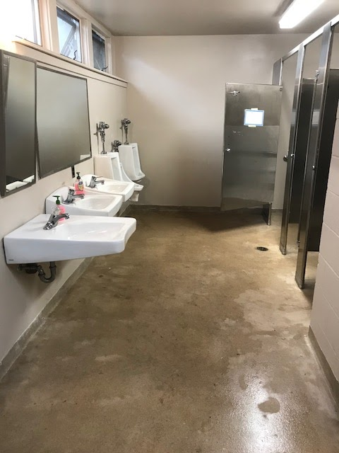
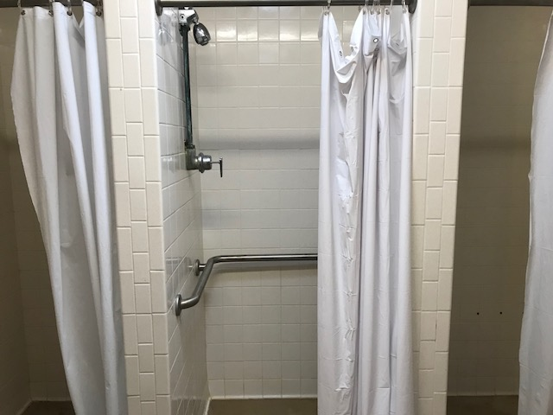
Bath House
Notes:
Each Cabin Loop has a bath house that has several sinks, showers, and toilets.
The bath houses have electricity and warm water.

Slide 10
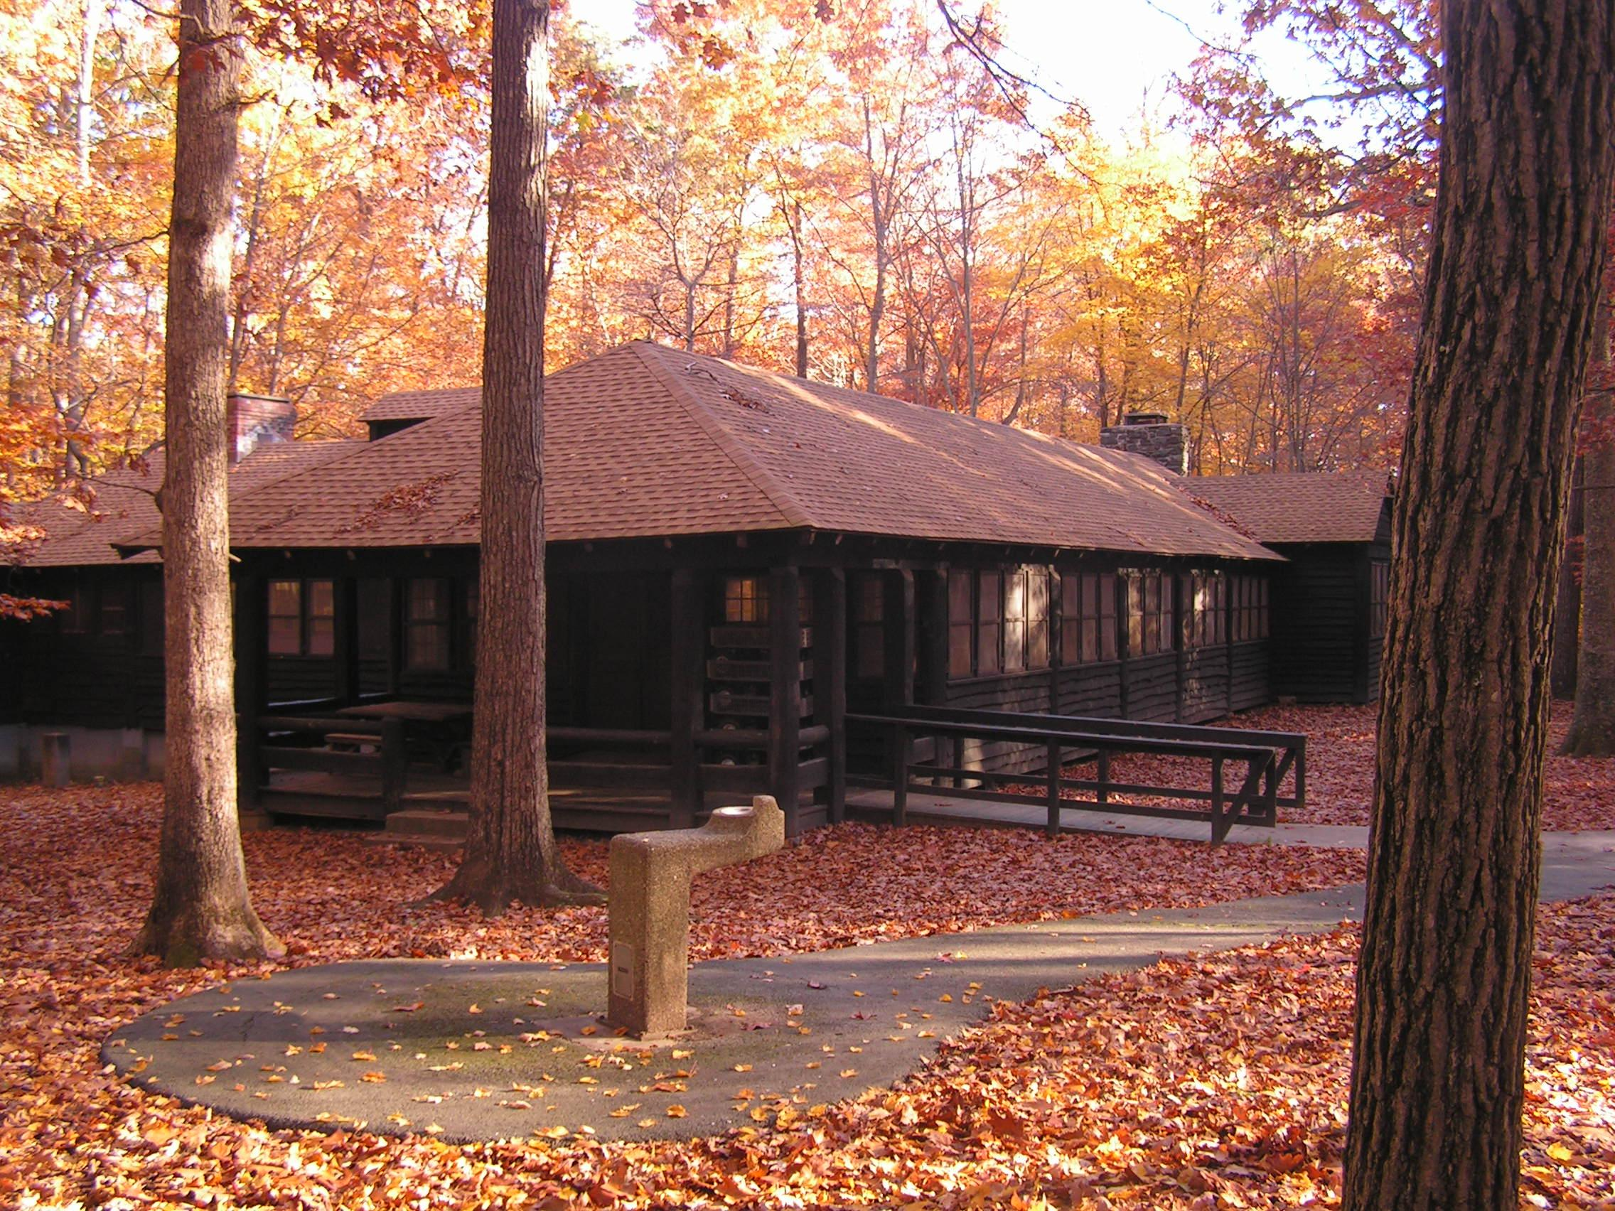
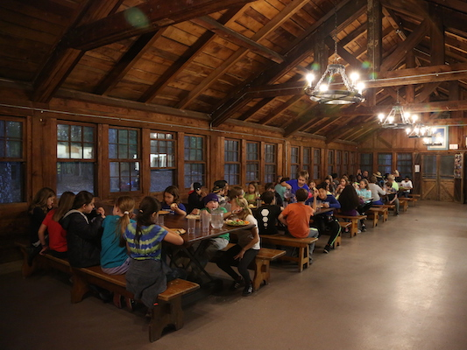
Dining
Dining Lodge
Inside the Dining Lodge
Notes:
Breakfast and dinner will be served in the dining lodge. This building will also serve as the main meeting place on campus.
Meals are served cafeteria style and there are plenty of options
Kitchen staff will be receiving information about dietary needs and allergies before the program and will make the needed accommodations
Food is nutritious
Sample breakfast:
Eggs, turkey sausage, hash browns, oatmeal, fruit salad
Sample Lunch (served on the trail):
Turkey & cheese sandwich, hummus with carrots, celery sticks, trail mix
Sample dinner:
Baked Pasta w/ cheese and marinara sauce, broccoli, breadsticks, salad, brownie (dessert)

Slide 11
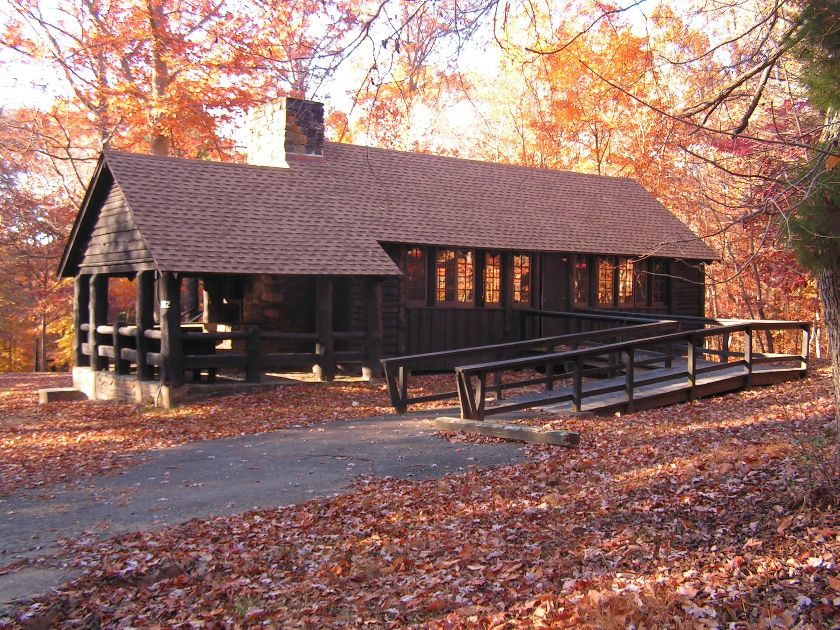
Microscope Lab
Notes:
There are several lodges on campus that can serve as indoor classrooms. Don’t plan on staying inside all day, though. Be prepared to be outside in inclement weather.

Slide 12
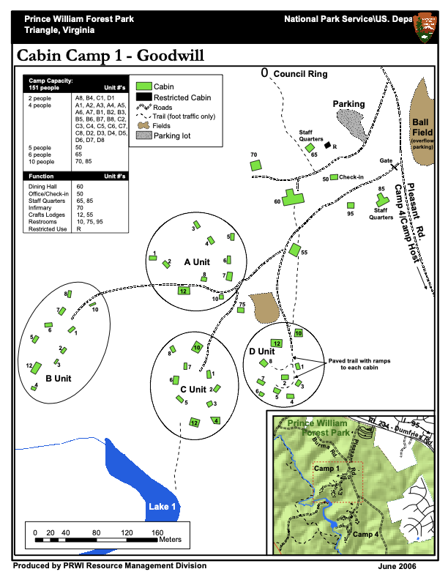
Cabin Camp 1
Notes:
Campus Map
Girls and boys usually in separate cabin units (some small groups may all be in one unit)
During some programs, the campus is shared by 2 or more schools. In that case, cabin assignments will be made according to participant numbers. Typically schools will used A & B Unit together or C & D Unit together
-NOTE: all equipment will be dropped off at the ball-field, about 1/5 of a mile from cabin loops: don’t bring more than you can carry! One back-pack for the trail, sleeping bag, and one medium-sized duffle bag with clothes, etc.

Slide 13
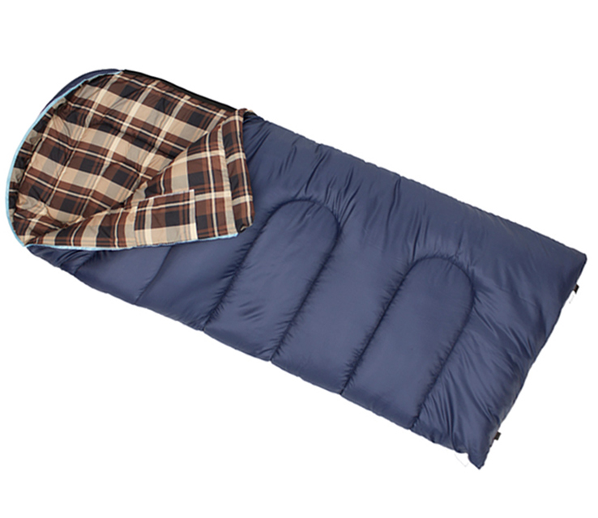
What to Bring: Bedding
Warm Sleeping Bag
and/or
Warm Blankets and Sheets
Pillow
Notes:
Please look at the Clothing and Equipment List provided by your Group Coordinator

Slide 14
What to Bring: Clothing
Good gear is functional, but doesn’t need to be fancy!
Read the packing list carefully and be prepared for all kinds of weather and for getting dirty.
rain gear
sturdy shoes
warm hat
gloves
extra socks
sun hat
medications
flashlight
toiletries
towel/wash cloth
Notes:
You don’t need to go out and buy brand new clothes and equipment! Borrow what you can, you should be well-prepared, but remember it’s only 3 days.
Rain jackets are preferred, a warm fleece jacket with a poncho will work as well.
Bring hiking boots if you have them, but sturdy sneakers will work as well. An extra pair of shoes to wear around camp and sandals for the bath house are recommended.
3-4 pairs of socks are recommended, bring one just for sleeping in the cabin
Students are strongly advised NOT TO WEAR SHORTS: temperatures may vary drastically, also shorts will limit the ability to hike off-trail through sometimes thick under-brush.
Students must bring medications with them (including inhalers, etc.) Chaperones will need to be sure that students have all of the medications that they may need while on the trail or on campus.
NOTE: Parents, please tell your Group Coordinator if there are items that your child will not have. NatureBridge can loan certain items. We want all students to participate and don’t want anyone to stay home because they don’t have certain things.

Slide 15
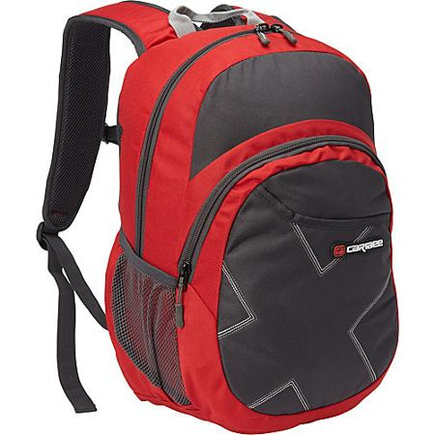
What to Bring: Daypack
Carry in your backpack every day:
Bag lunch for 1st Day!
Large water bottle (full of water)
Journal and two sharp pencils
Extra layers of warm clothing
Hat and gloves
Rain gear
Bandana (used for lunch placemat)
(Optional: camera or binoculars)
Notes:
Things to have in daypacks:
Remind students to only bring lunch for the first day, no other food is allowed in cabins!*
Chaperones are responsible for making sure students have necessary medications with them on the trail (inhalers, epi-pens, etc.).
Students should have an extra layer at all times, but the type of layer will depend on the temperature/weather

Slide 16
Student and Family Agreements
All students and adults are expected to fully participate in all aspects of the program.
Parents/guardians are responsible for picking up their child in Prince William Forest if they are too ill to hike, injured or need to be sent home because of a behavior violation.
Safe and inclusive behavior is important. Students are expected to follow all behavior guidelines. Students must review student expectations prior to the trip.
NatureBridge Cell Phone Policy:
Policy [4.16] When student participants are in learning groups with NatureBridge educators and school chaperones, cell phones should be set in airplane mode and used only for taking photos, video or specific school projects. When student participants are not in learning groups, any cell phone use will be supervised by teachers and chaperones. Student participants may not use cell phones in NatureBridge cabins, dining halls, or bathrooms.
Notes:
NatureBridge will do what is possible to keep students on site and participating in the program.
NatureBridge staff will be included in any discussions about students leaving the program early.
NatureBridge cell phone policy: We don’t allow cell phones to be a distraction during program time. We ask that if students and chaperones have phones with them, they remain on airplane mode throughout the day. Students are permitted to use the camera feature on their phones at appropriate times.
We advise schools to develop a cell phone policy that works best for them. Here are some options:
No cell phones. Teachers provide phone numbers to parents to contact in case of emergency, teachers will contact parents if there are any issues with students
RECOMMENDED if students are permitted to bring phones, they are collected by teachers. All phones are labeled and passed out for a 10-20 minute window in the evening before or after dinner. Students are permitted to call/text home, and then return phones to teachers. Parents are able to contact teachers in case of emergency.
NOTE: Students cannot use cell phones at any time in cabins, dining hall, or bathrooms. This is for the safety of all participants.

Slide 17
Next Steps
Registration Forms:
Your school’s group coordinator will give you a copy of the NatureBridge registration form.
Modes of Communication:
NatureBridge will be in direct contact with your school’s group coordinator. Please direct all questions to that individual.
Timeline and Calendar:
Please adhere to all deadlines dictated by your school’s group coordinator. This ensures that NatureBridge can provide the safest/highest quality program for your student.
Visit NatureBridge’s website to learn more: naturebridge.org/princewilliamforest
Notes:
The Group Coordinator from the school will be the main point of contact for parents and participants. If there are questions that the Group Coordinator cannot answer, they will contact NatureBridge staff. In some cases, parents will be referred directly to NatureBridge staff.

Slide 18
Emergency Contact Information
Emergency Contact NatureBridge Cell Phone: 703-634-9041 (Google Voice)
Will be answered by Jim Serfass or other NatureBridge staff member
Contact Group Coordinator for non-emergencies
Notes:
The Group Coordinator is expected to share their contact information with parents. Other chaperones’ contact information can also be provided.
-NatureBridge Google voice number: 703-634-9041 This number is for emergencies only. If parents need to contact their children, but cannot reach a teacher, they should call this number. This number should not be called to “check on” student participants.

Slide 19
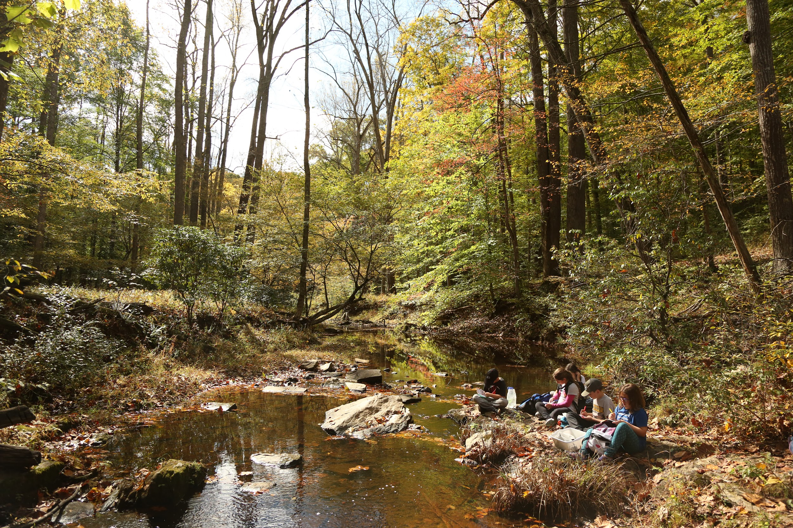
Questions?
NatureBridge looks forward to welcoming your school to Prince William Forest!
Notes:
Frequently Asked Questions:
Q: cabin and group assignments: teachers will determine who is in which cabin and group, this can be done a few different ways.
A: Option 1: Students can write the names of 2-3 students they want to share a cabin with, students that share a cabin are then assigned to different learning groups (this works especially well for schools bringing 4 learning groups)
Option 2: Students can list people they definitely don’t want to share a cabin/learning group with
Option 3: Group Coordinator assigns all cabins/groups with no input from students
Q: Campus safety procedures (at night):
A: Adult chaperones in each cabin unit, 1 NatureBridge staff member on-site serving as on-call contact for emergencies, park dispatch: very quick response time. There is a gate on the road leading in to Cabin Camp 1, also the camp is separated from all other roads in the park, not easily accessible from any other point in the park.
Q: pick-up/drop-off times
A: Those arrangements are made by the Group Coordinator. Schools often designate a room or space for students to store equipment on the days they depart and return on the trip.
Q: How’s the food? How’s it served?
A: The food is very good. Breakfast and Dinner are served cafeteria-style in the dining hall. Lunch will be picnic-style with in learning groups.
Q: Pick-up/drop-off procedures at school
A: This is all up to the school, group coordinators should check in with teachers/staff ahead of time to determine the best place to store luggage, etc.

