Slide 1
Prince William Forest Park
Notes:
This presentation is meant to prepare you and your students for your school’s trip to the NatureBridge program at Prince William Forest Park.

Slide 2
Información General
Acerca de NatureBridge
El salón de clases Prince William Forest
Un día típico en NatureBridge
Grupos de aprendizaje
Alojamiento y servicio de alimentos
¿Qué llevar?
Reglas para los alumnos y las familias
Pasos siguientes

Slide 3
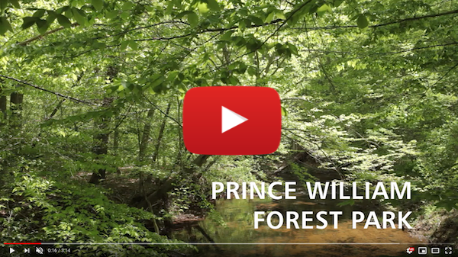
Acerca de NatureBridge
Organización sin fines de lucro fundada en 1971
Socio del Servicio de Parques Nacionales
Los campamentos incluyen: Golden Gate, Yosemite y Olympic
Recibe a más de 30,000 alumnos de 600 escuelas cada año.
Notes:
NatureBridge:
•nonprofit organization
•Partner of the National Park Service, our other campuses are in Golden Gate and Yosemite in California, and Olympic in Washington state.
•NatureBridge has been offering programs since 1971, has served over a million students, and serves at least 30,000 each year
•Prince William Forest Park program – This is the 8th school year of our first East Coast program, serves over 40 schools and about 2,000 students each year

Slide 4
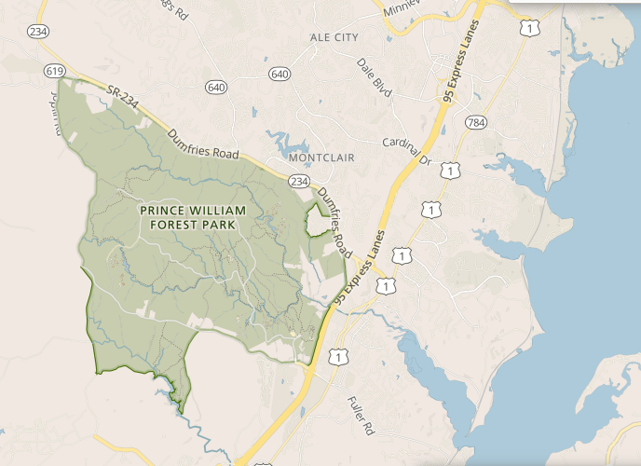
Prince William Forest
A sólo 35 millas al sur de Washington, D.C.
15,000 acres de bosque en las faldas de las montañas.
Riachuelos y cascadas cristalinos, 37 millas de senderos
Notes:
Prince William Forest Park – National Park in your backyard!
•23 square mile park, bordering Quantico Marine Base
•15,000 acres of piedmont forest
•Pristine streams, waterfalls, 37 miles of trails
•The star marks the location of Cabin Camp 1, the site of NatureBridge programs

Slide 5
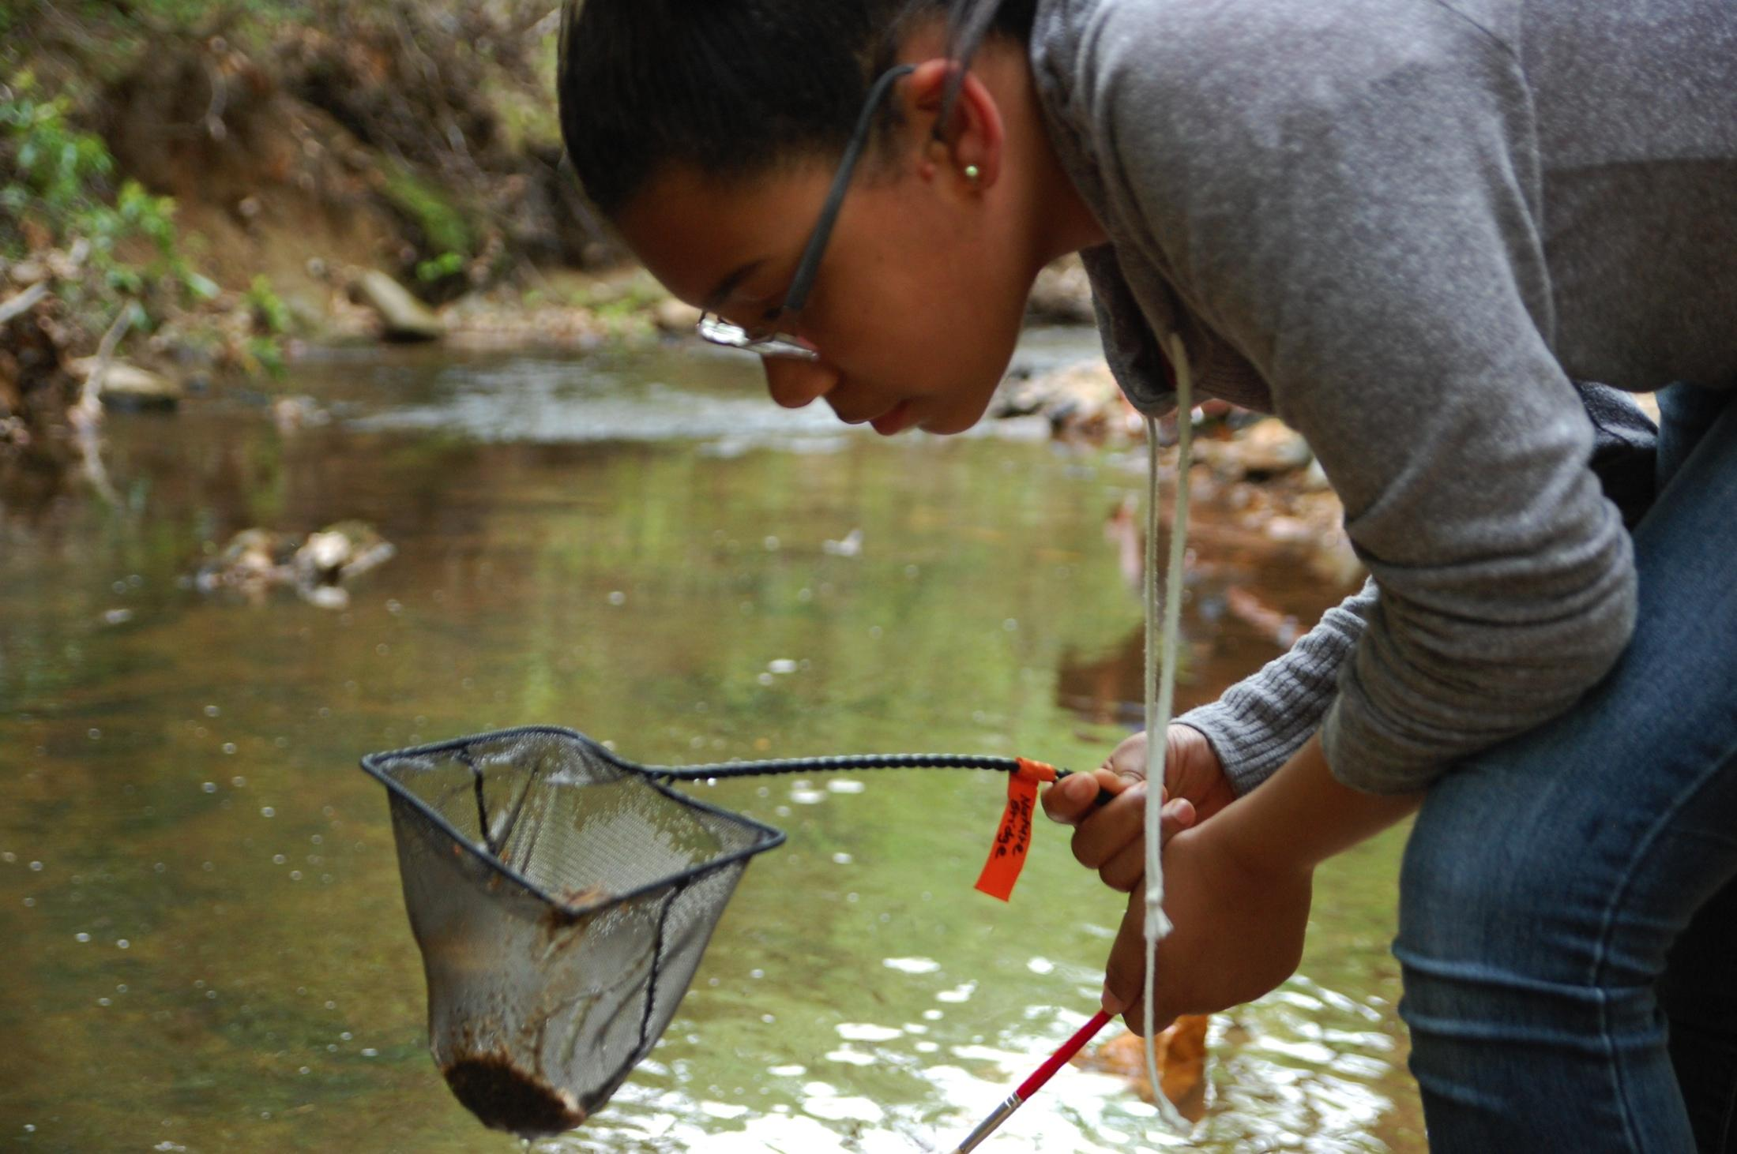
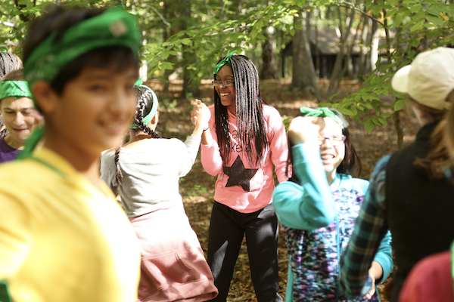
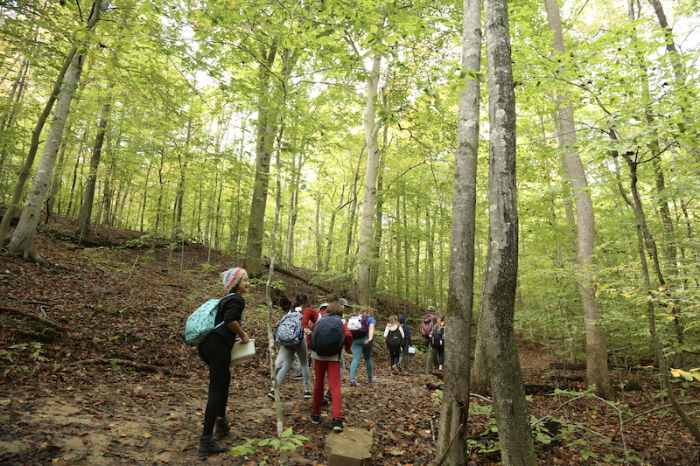
El salón de clases Prince William Forest
Ciencias ambientales
Espíritu de equipo e introspección
Experiencias al aire libre
Notes:
The Park provides a beautiful setting for science experiments, spending time outdoors, and getting to know classmates and teachers better.

Slide 6
Ejemplo de un día
8:00 a.m. Desayuno*
9:00 a.m. Inicia el día de senderismo ~12:00 p.m. Almuerzo durante la caminata ~4:00 p.m. Actividades recreativas (supervisadas por los chaperones) 6:00 p.m. Cena* 7:15 p.m. Programa nocturno 9:30 p.m. Campamento en silencio, se apagan las luces
*Los horarios pueden cambiar si hay varios turnos de comida. Primer turno de comidas: 7:00 a. m. y 5:00 p. m. Segundo turno de comidas: 8:00 a. m. y 6:00 p. m.
Notes:
Sample activities on the trail: - water quality testing, identifying plants and animals (including the park’s many reptiles and amphibians), group games and team challenges, hiking up to 4 miles in a day (spread out with activities in between)
Science investigations: asking questions, making observations, collecting data
During meals: lessons on food waste, landfills, and composting
We support our Teachers and Chaperones. They supervise students before and after the trail day (until 9:00AM and after 4:00PM)

Slide 7
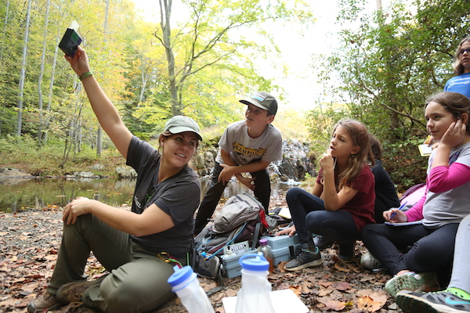
Grupos de aprendizaje
12-15 estudiantes y 1 o 2 chaperones
Convivencia durante la caminata
Los grupos de aprendizaje son dirigidos por instructores profesionales de NatureBridge.
Licenciatura o experiencia laboral y capacitación equivalente
antecedentes verificados
certificados para manejar los riesgos en el campo y capacitados en primeros auxilios en entornos silvestres.
El coordinador de grupos de su escuela organizará los grupos de aprendizaje.
Notes:
Educators – high-quality, outdoor teachers
•Our focus is on personal growth, improved interpersonal skills, and increased academic ability
•We strive to create a community atmosphere in which all students experience support and success.
•Educators prepare specifically for each group they work with using information provided by the school

Slide 8
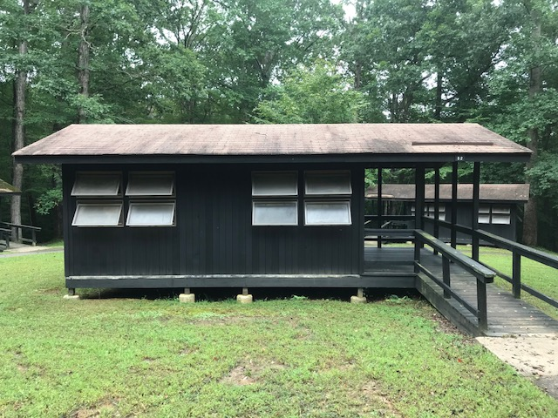
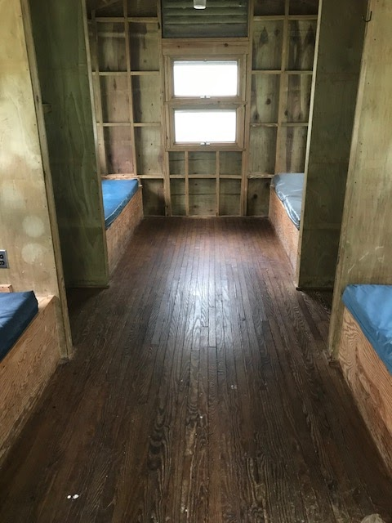
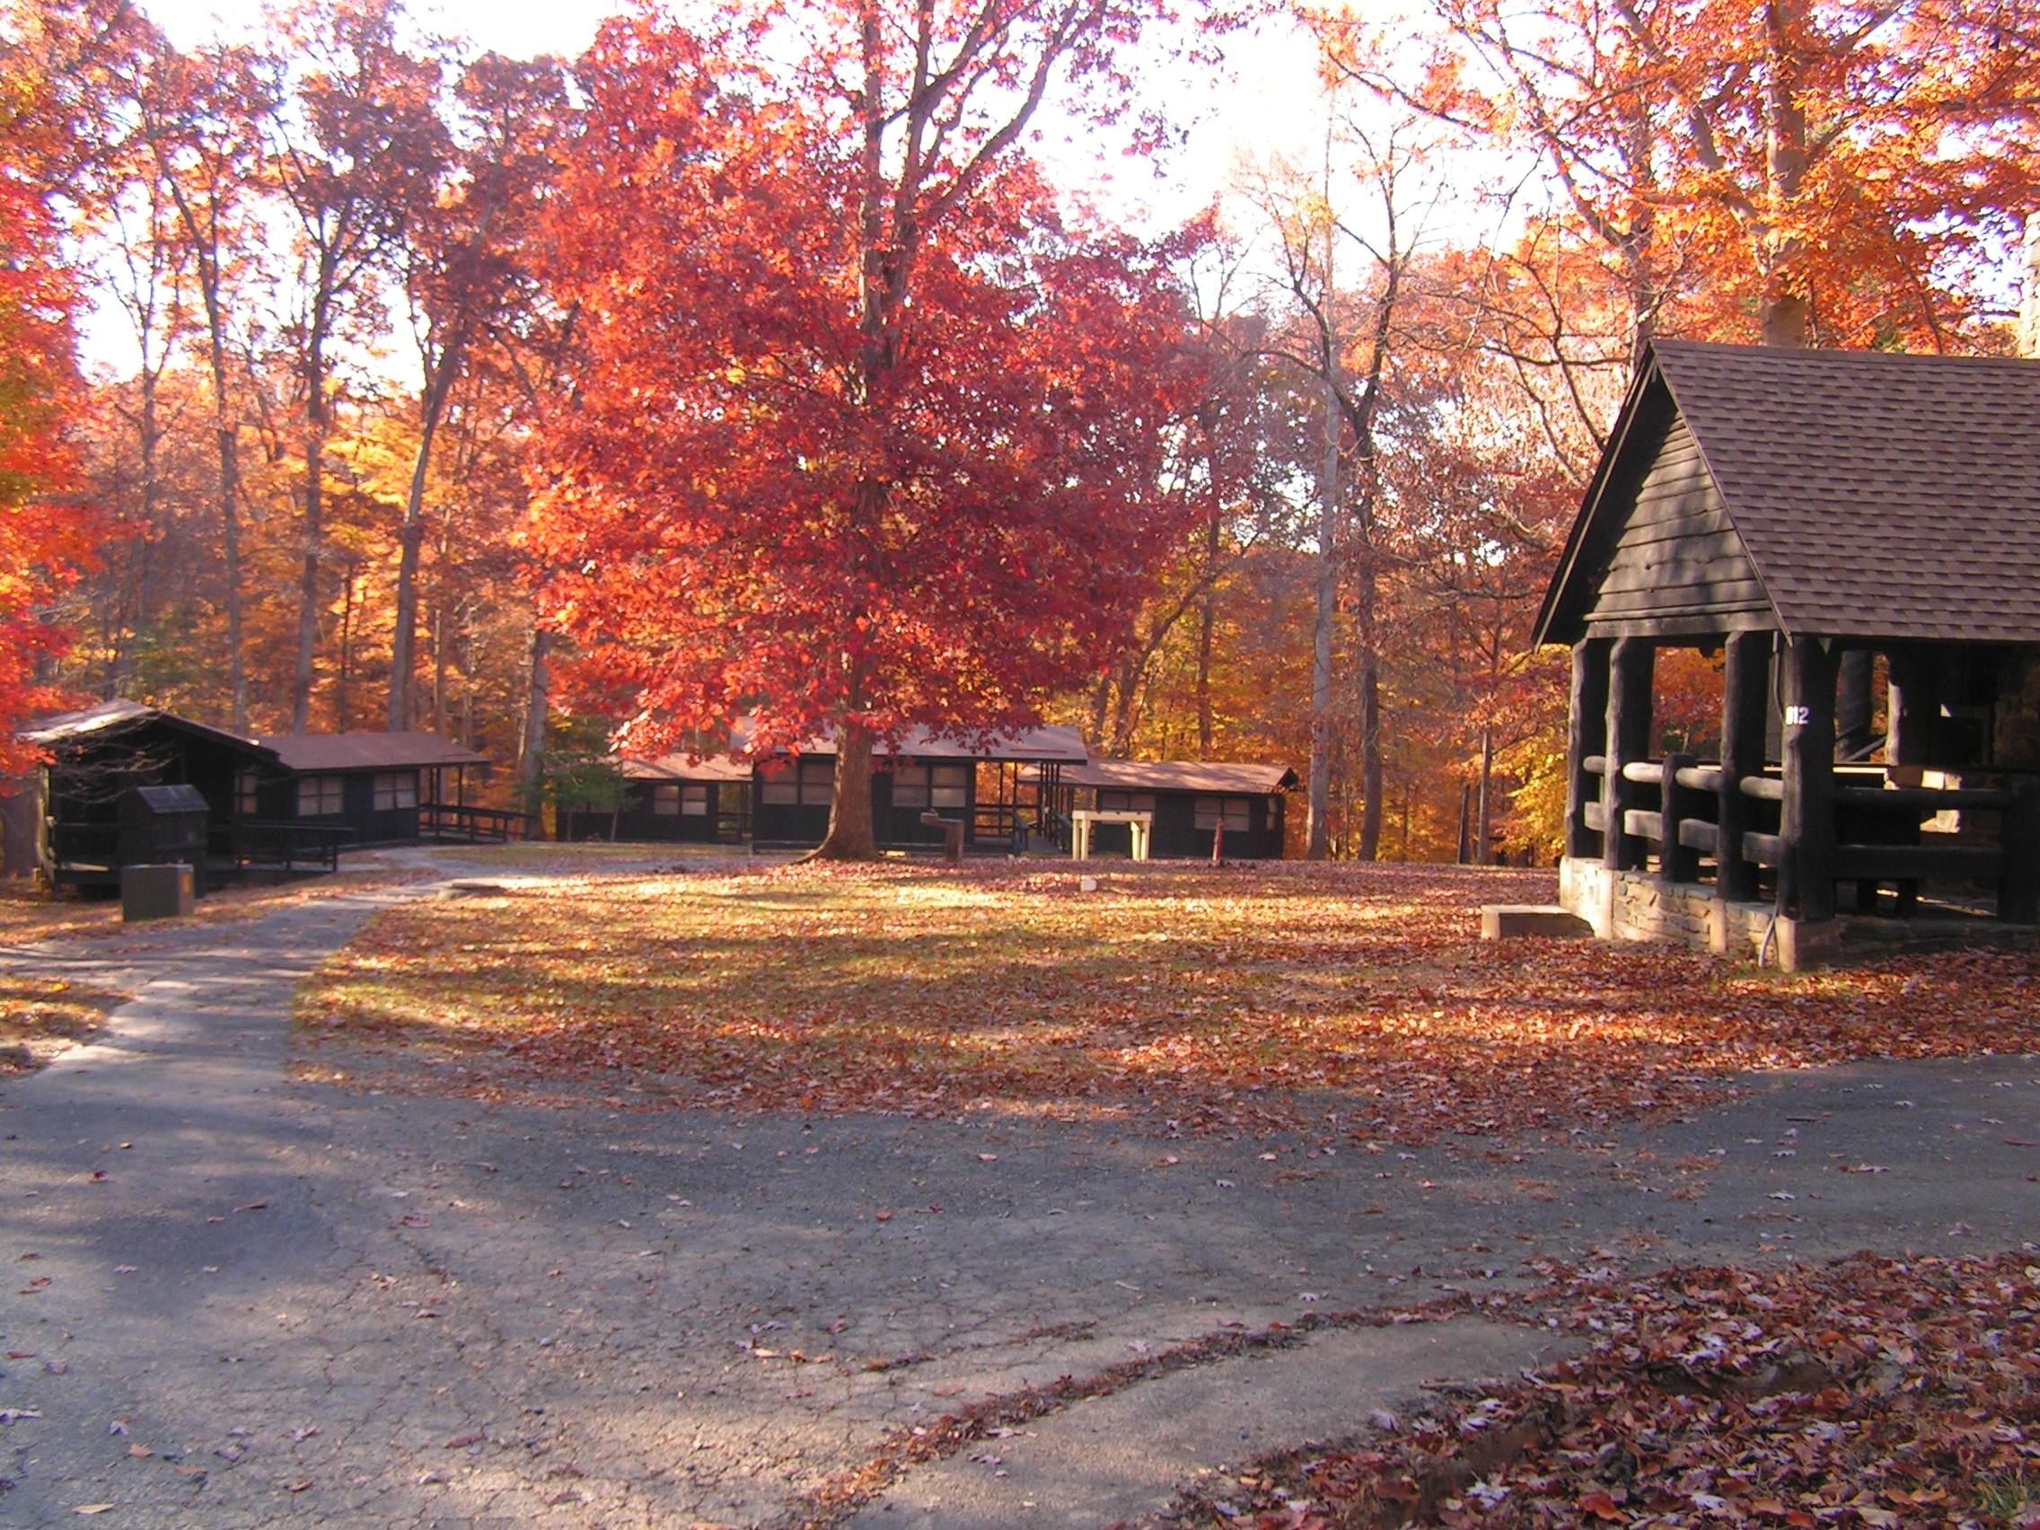
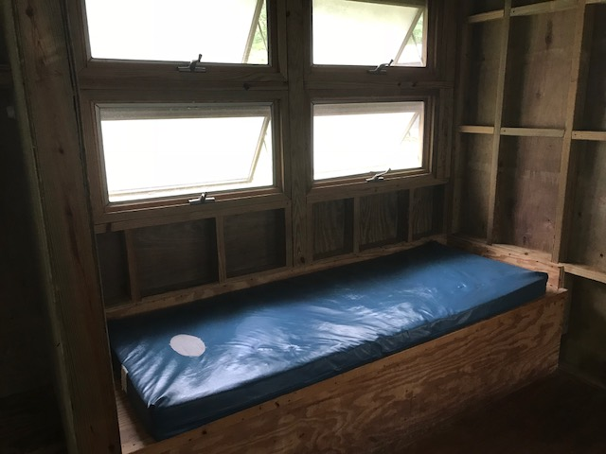
Alojamiento
Campamento de cabañas 1
Interior de las cabañas
Notes:
Accommodations:
4-6 students per cabin (some bunk beds, some single)
Foam mattresses
You will bring sleeping bag, pillow, etc
There are eight cabins in each Cabin Unit.
Schools can choose to assign cabins however they like, as long as there are at least two adults in each Cabin Loop.
There will typically not be an adult in every cabin with students, but all of the cabins are close to one another

Slide 9
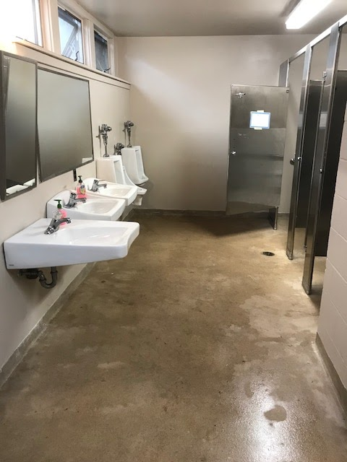
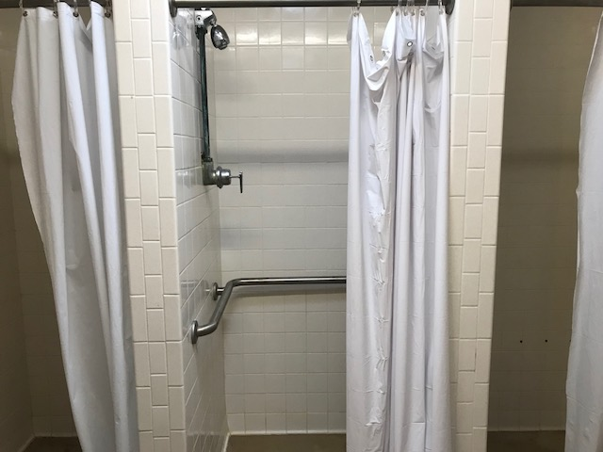
Baños y regaderas
Notes:
Each Cabin Loop has a bath house that has several sinks, showers, and toilets.
The bath houses have electricity and warm water.

Slide 10
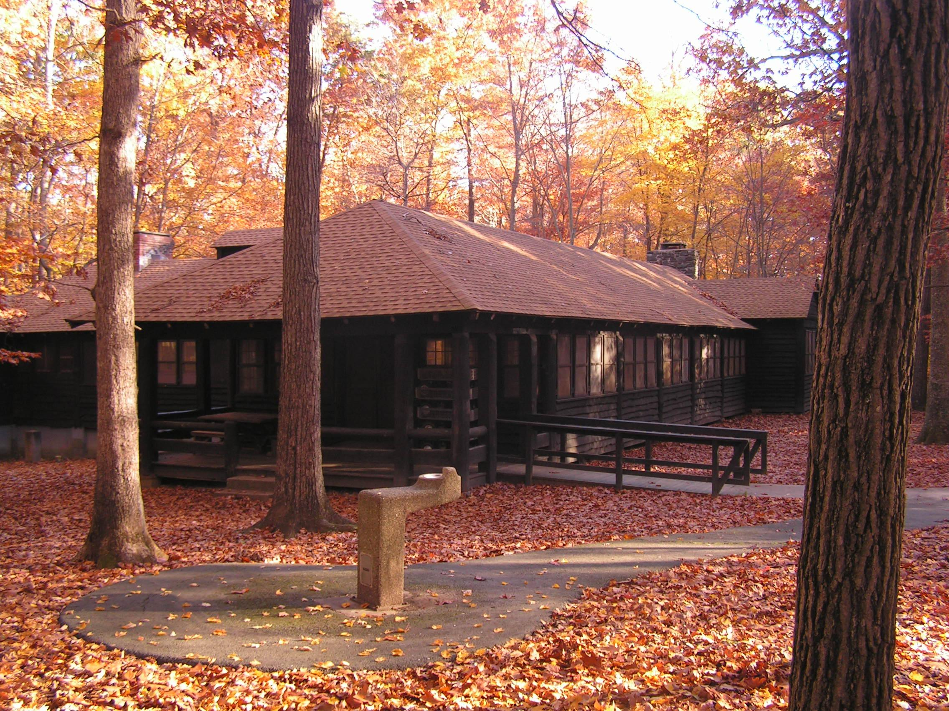
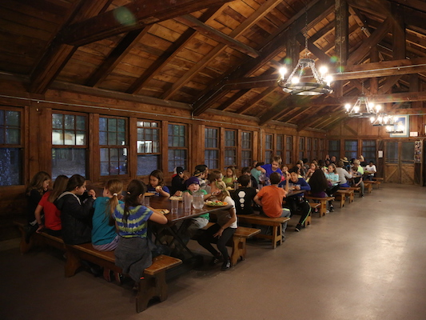
Servicio de comida
Comedor
Interior del comedor
Notes:
Breakfast and dinner will be served in the dining lodge. This building will also serve as the main meeting place on campus.
Meals are served cafeteria style and there are plenty of options
Kitchen staff will be receiving information about dietary needs and allergies before the program and will make the needed accommodations
Food is nutritious
Sample breakfast:
Eggs, turkey sausage, hash browns, oatmeal, fruit salad
Sample Lunch (served on the trail):
Turkey & cheese sandwich, hummus with carrots, celery sticks, trail mix
Sample dinner:
Baked Pasta w/ cheese and marinara sauce, broccoli, breadsticks, salad, brownie (dessert)

Slide 11
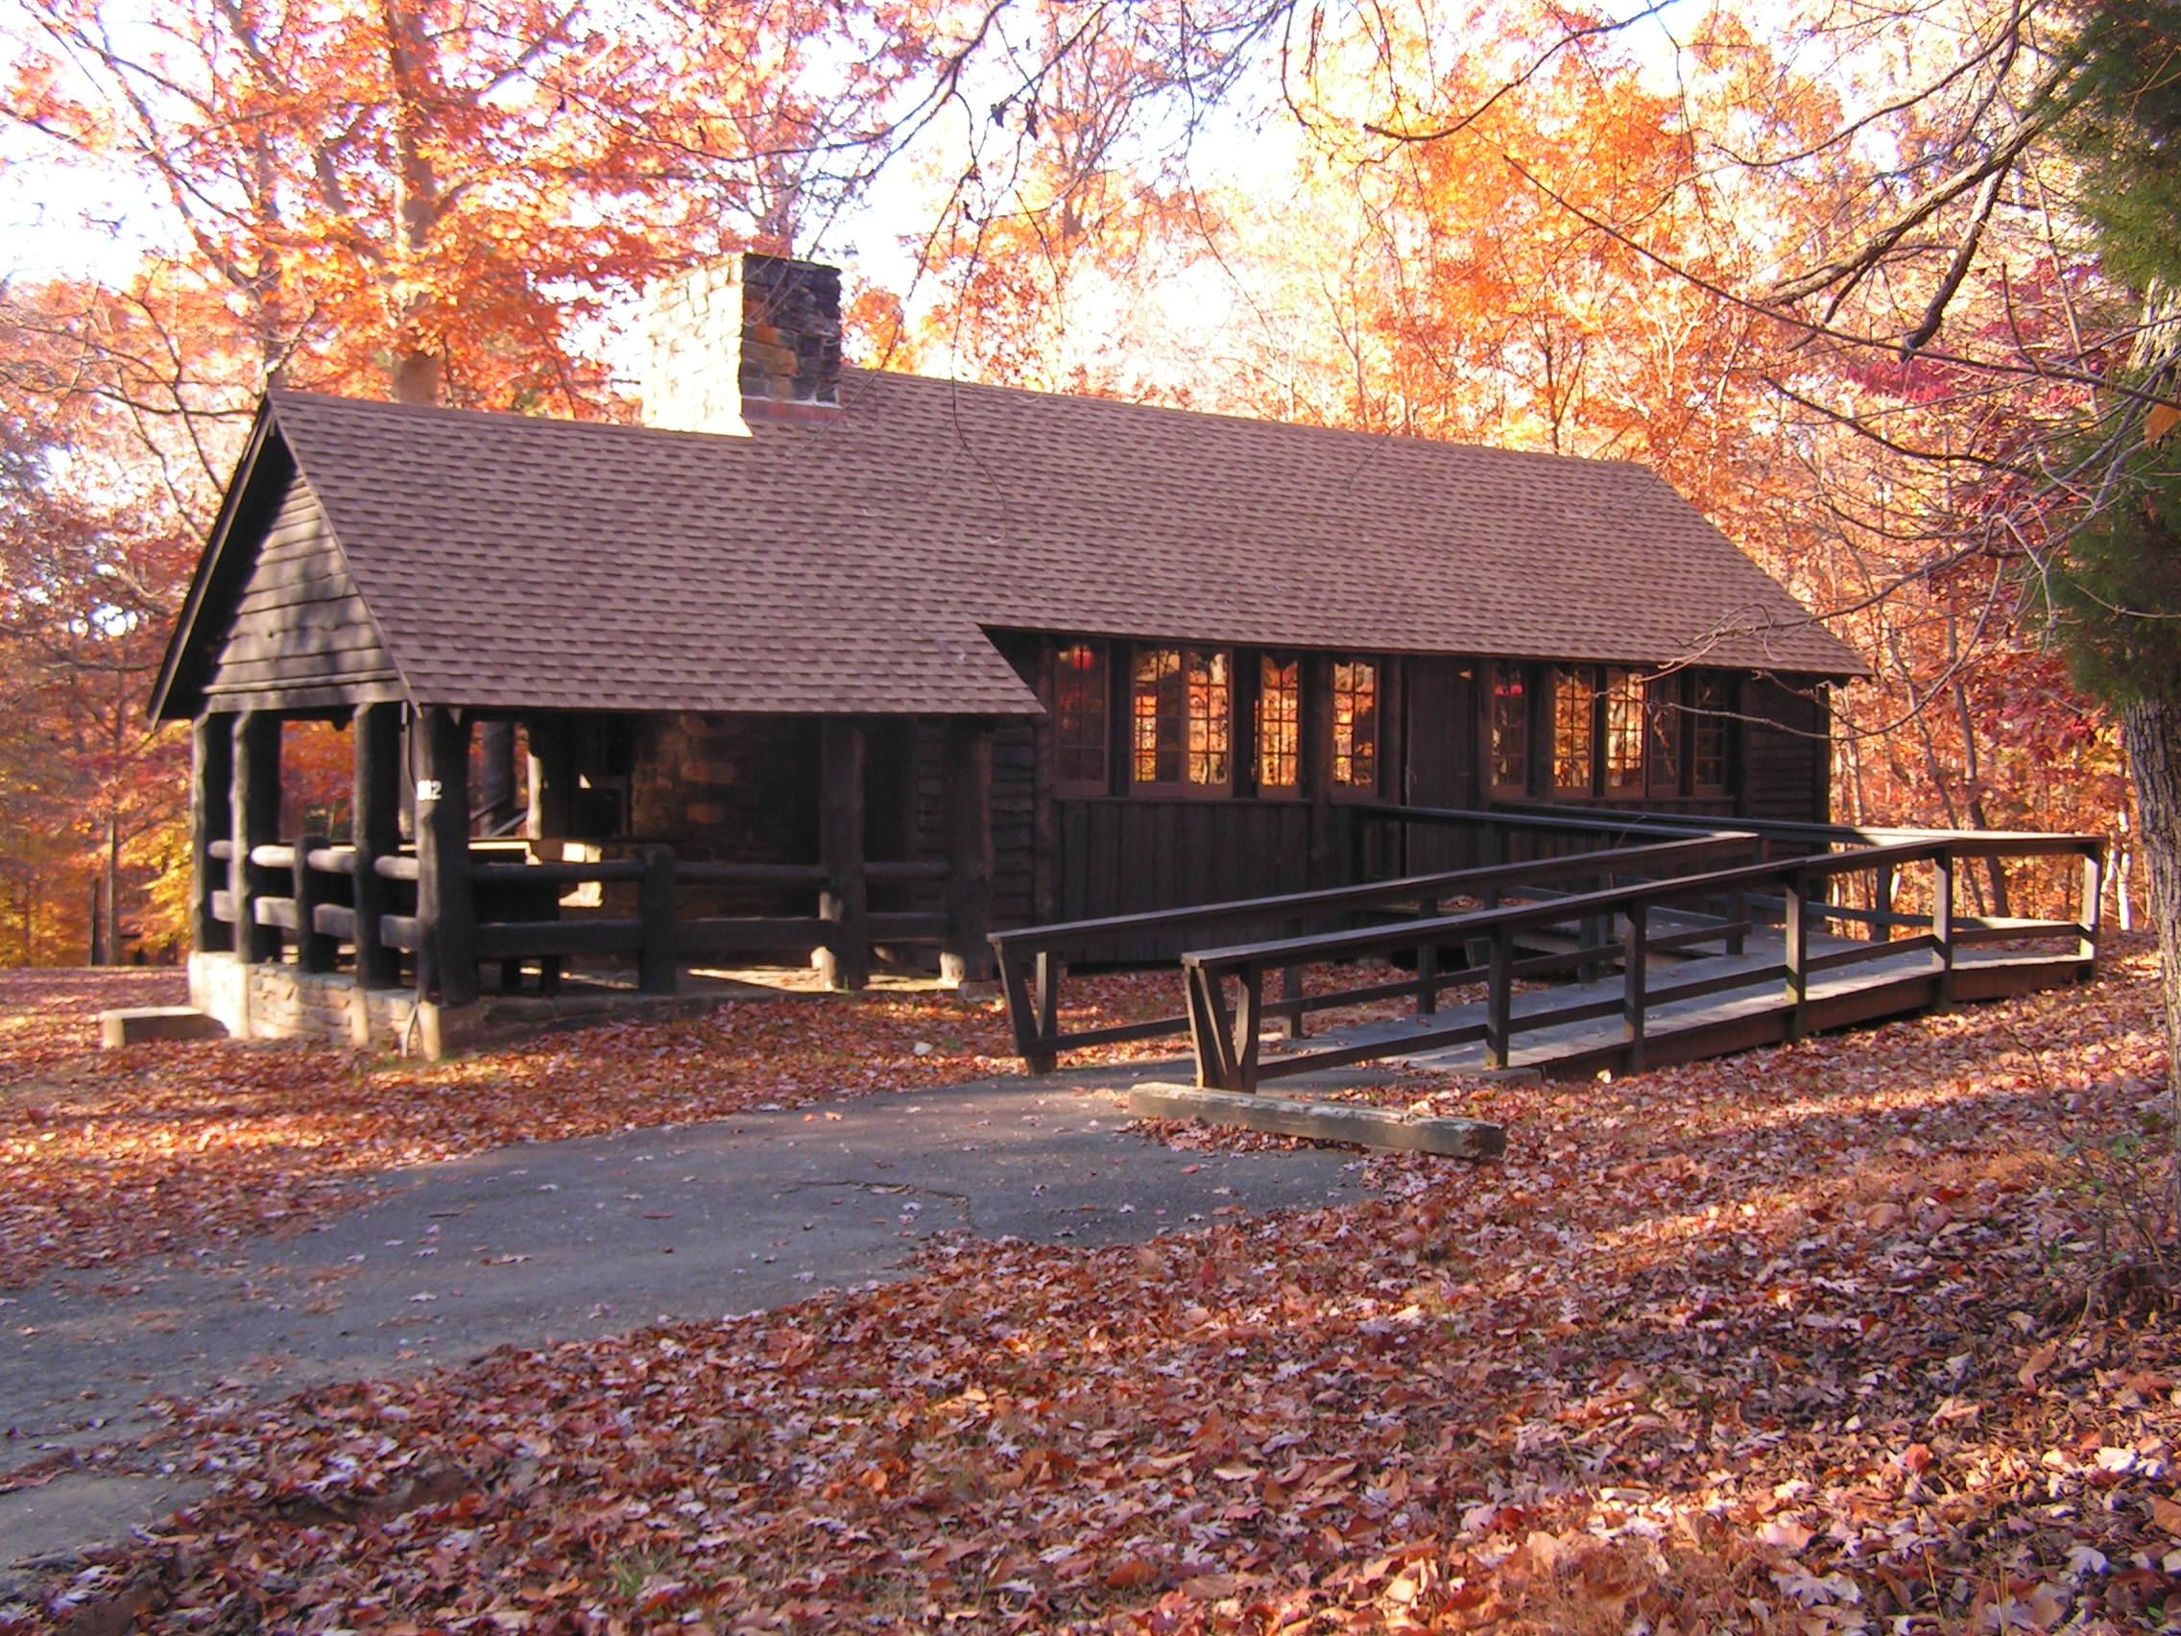
Laboratorio con microscopios
Notes:
There are several lodges on campus that can serve as indoor classrooms. Don’t plan on staying inside all day, though. Be prepared to be outside in inclement weather.

Slide 12
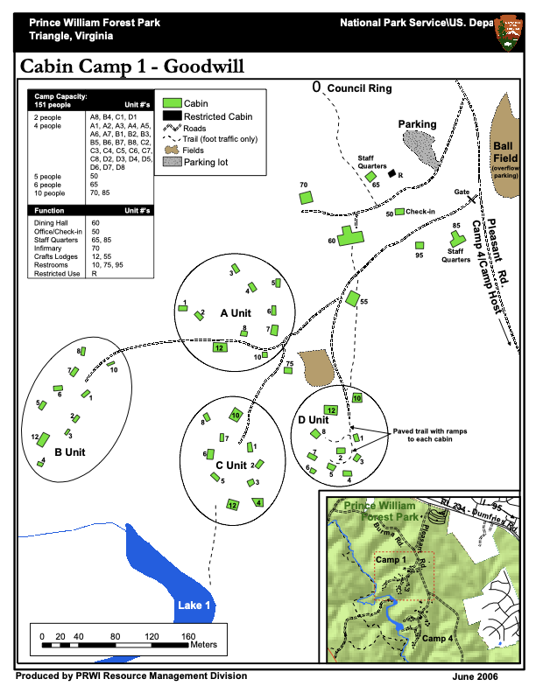
Campamento de cabañas 1
Notes:
Campus Map
Girls and boys usually in separate cabin units (some small groups may all be in one unit)
During some programs, the campus is shared by 2 or more schools. In that case, cabin assignments will be made according to participant numbers. Typically schools will used A & B Unit together or C & D Unit together
-NOTE: all equipment will be dropped off at the ball-field, about 1/5 of a mile from cabin loops: don’t bring more than you can carry! One back-pack for the trail, sleeping bag, and one medium-sized duffle bag with clothes, etc.

Slide 13
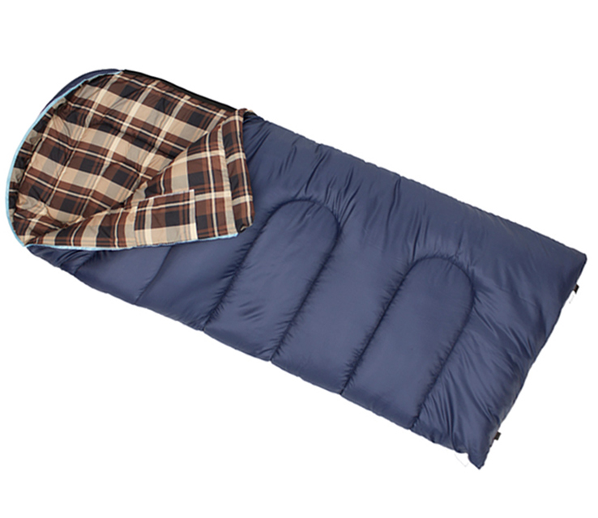
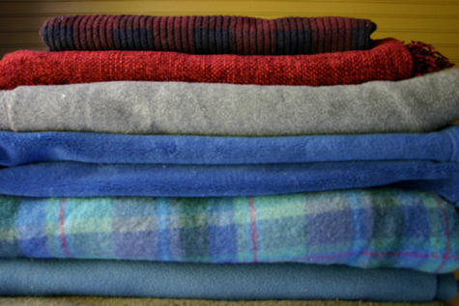
¿Qué llevar? Ropa de cama
Saco de dormir abrigador
y/o
Frazadas y sábanas abrigadoras
Almohada
Notes:
Please look at the Clothing and Equipment List provided by your Group Coordinator

Slide 14
¿Qué llevar? Vestimenta
Lo ideal es usar atuendos prácticos y funcionales, no necesariamente sofisticados.
Lean la lista del equipo necesario con atención y prepárense para todo tipo de climas, así como para ensuciarse.
ropa para clima lluvioso
zapatos de uso rudo
gorro abrigador
guantes
calcetines suficientes
gorra que proteja del sol
medicamentos
linterna
artículos de aseo personal
toalla y toalla facial
Notes:
You don’t need to go out and buy brand new clothes and equipment! Borrow what you can, you should be well-prepared, but remember it’s only 3 days.
Rain jackets are preferred, a warm fleece jacket with a poncho will work as well.
Bring hiking boots if you have them, but sturdy sneakers will work as well. An extra pair of shoes to wear around camp and sandals for the bath house are recommended.
3-4 pairs of socks are recommended, bring one just for sleeping in the cabin
Students are strongly advised NOT TO WEAR SHORTS: temperatures may vary drastically, also shorts will limit the ability to hike off-trail through sometimes thick under-brush.
Students must bring medications with them (including inhalers, etc.) Chaperones will need to be sure that students have all of the medications that they may need while on the trail or on campus.
NOTE: Parents, please tell your Group Coordinator if there are items that your child will not have. NatureBridge can loan certain items. We want all students to participate and don’t want anyone to stay home because they don’t have certain things.

Slide 15
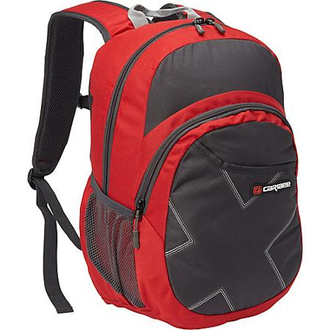
¿Qué llevar? Mochila para el día
Todos los días, la mochila debe contener: • Almuerzo para el primer día
• Botella grande de agua (llena)
• Diario y dos lápices afilados
• Capas adicionales de ropa abrigadora
• Gorro y guantes
• Ropa para clima lluvioso
• Paliacate (para usarlo como mantel individual)
• (Opcional: cámara o binoculares)
Notes:
Things to have in daypacks:
Remind students to only bring lunch for the first day, no other food is allowed in cabins!*
Chaperones are responsible for making sure students have necessary medications with them on the trail (inhalers, epi-pens, etc.).
Students should have an extra layer at all times, but the type of layer will depend on the temperature/weather

Slide 16
Reglas para los alumnos y las familias
Se espera que todos los alumnos y adultos participen en todos los aspectos del programa.
Los padres o tutores son responsables de recoger a sus hijos en Prince William Forest si se encuentran demasiado enfermos para realizar las actividades, se lesionan o son expulsados por alguna falta de conducta.
Es importante demostrar un comportamiento prudente e incluyente. Se espera que los alumnos acaten las reglas de conducta. Los alumnos deben leer lo que se espera de ellos antes de iniciar la experiencia.
Política de NatureBridge acerca de teléfonos celulares:
Política [4.16] Cuando los alumnos estén en grupos de aprendizaje con los instructores o chaperones de la escuela, los teléfonos celulares deben estar en modo avión y solamente pueden utilizarse para tomar fotografías o video, o para proyectos escolares específicos. Cuando no se encuentren en grupos de aprendizaje, el uso de los teléfonos celulares será bajo la supervisión de instructores y chaperones. Los alumnos no pueden usar teléfonos celulares en las cabañas, los comedores o los baños de NatureBridge.
Notes:
NatureBridge will do what is possible to keep students on site and participating in the program.
NatureBridge staff will be included in any discussions about students leaving the program early.
NatureBridge cell phone policy: We don’t allow cell phones to be a distraction during program time. We ask that if students and chaperones have phones with them, they remain on airplane mode throughout the day. Students are permitted to use the camera feature on their phones at appropriate times.
We advise schools to develop a cell phone policy that works best for them. Here are some options:
No cell phones. Teachers provide phone numbers to parents to contact in case of emergency, teachers will contact parents if there are any issues with students
RECOMMENDED if students are permitted to bring phones, they are collected by teachers. All phones are labeled and passed out for a 10-20 minute window in the evening before or after dinner. Students are permitted to call/text home, and then return phones to teachers. Parents are able to contact teachers in case of emergency.
NOTE: Students cannot use cell phones at any time in cabins, dining hall, or bathrooms. This is for the safety of all participants.

Slide 17
Pasos siguientes
Formularios de registro: El coordinador de grupos de su escuela les dará una copia del formulario de registro.
Métodos de comunicación:
NatureBridge estará en contacto directo con el coordinador de grupos de su escuela. Dirijan todas sus preguntas a dicha persona.
Cronograma y calendario:
Acaten todos los plazos que indique el coordinador de grupos de su escuela. De este modo, NatureBridge puede brindar un programa de la más alta calidad y mayor seguridad para el alumno.
Visite la página web de NatureBridge para obtener más información: naturebridge.org/princewilliamforest
Notes:
The Group Coordinator from the school will be the main point of contact for parents and participants. If there are questions that the Group Coordinator cannot answer, they will contact NatureBridge staff. In some cases, parents will be referred directly to NatureBridge staff.

Slide 18
Información de contacto para emergencias
Contacto para emergencias
Teléfono celular de NatureBridge: 703-634-9041
(Google Voice)
Les atenderá Jim Serfass u otro miembro del personal de NatureBridge.
Si no es una emergencia, comuníquense con el coordinador de grupos.
Notes:
The Group Coordinator is expected to share their contact information with parents. Other chaperones’ contact information can also be provided.
-NatureBridge Google voice number: 703-634-9041 This number is for emergencies only. If parents need to contact their children, but cannot reach a teacher, they should call this number. This number should not be called to “check on” student participants.

Slide 19
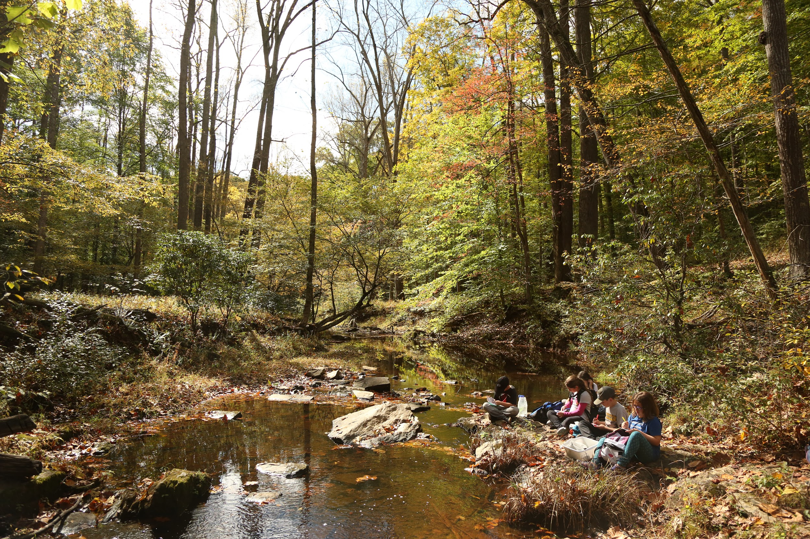
¿Preguntas?
¡NatureBridge está ansioso por recibir a su escuela en Prince William Forest!
Notes:
Frequently Asked Questions:
Q: cabin and group assignments: teachers will determine who is in which cabin and group, this can be done a few different ways.
A: Option 1: Students can write the names of 2-3 students they want to share a cabin with, students that share a cabin are then assigned to different learning groups (this works especially well for schools bringing 4 learning groups)
Option 2: Students can list people they definitely don’t want to share a cabin/learning group with
Option 3: Group Coordinator assigns all cabins/groups with no input from students
Q: Campus safety procedures (at night):
A: Adult chaperones in each cabin unit, 1 NatureBridge staff member on-site serving as on-call contact for emergencies, park dispatch: very quick response time. There is a gate on the road leading in to Cabin Camp 1, also the camp is separated from all other roads in the park, not easily accessible from any other point in the park.
Q: pick-up/drop-off times
A: Those arrangements are made by the Group Coordinator. Schools often designate a room or space for students to store equipment on the days they depart and return on the trip.
Q: How’s the food? How’s it served?
A: The food is very good. Breakfast and Dinner are served cafeteria-style in the dining hall. Lunch will be picnic-style with in learning groups.
Q: Pick-up/drop-off procedures at school
A: This is all up to the school, group coordinators should check in with teachers/staff ahead of time to determine the best place to store luggage, etc.

